Slide 1
Chapter 2: outline
2.1 principles of network applications
2.2 Web and HTTP
2.3 electronic mail
  SMTP, POP3, IMAP
2.4 DNS
2.5 P2P applications
2.6 video streaming and content distribution networks
2.7 socket programming with UDP and TCP
Application Layer
2-<number>

Slide 2
History of Electronic mail
Origins: Email dates back to the 1960s when ARPANET, a precursor to the internet, was developed. Early systems allowed users to send messages to one another within the same computer.
Development: In 1971, Ray Tomlinson implemented the first networked email system, introducing the “@” symbol to separate usernames from hostnames.
Commercial Use: By the 1990s, email became widely available, leading to its rapid adoption for personal and business communication
Application Layer
2-<number>

Slide 3
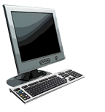
Electronic mail
outgoing
message queue
user mailbox
Three major components:
user agents
mail servers
simple mail transfer protocol: SMTP
User Agent
a.k.a. “mail reader”
composing, editing, reading mail messages
e.g., Outlook, Thunderbird, iPhone mail client
outgoing, incoming messages stored on server
user
agent
mail
server
user
agent
SMTP
mail
server
user
agent
SMTP
SMTP
user
agent
mail
server
user
agent
user
agent
Application Layer
2-<number>

Slide 4
Electronic mail: mail servers
Mail servers are specialized servers that handle the sending, receiving, and storing of email messages.
Incoming Mail Servers: These manage the reception of emails. Common protocols used include:
POP3 (Post Office Protocol 3): Downloads emails from the server to the user’s device, often deleting them from the server.
IMAP (Internet Message Access Protocol): Allows users to access and manage their emails directly on the server, enabling synchronization across multiple devices.
Outgoing Mail Servers: These handle the sending of emails using the SMTP protocol.
Application Layer
2-<number>

Slide 5
Electronic mail: mail servers
mail servers:
mailbox contains incoming messages for user
message queue of outgoing (to be sent) mail messages
SMTP protocol between mail servers to send email messages
  client: sending mail server
  “server”: receiving mail server
user
agent
mail
server
user
agent
SMTP
mail
server
user
agent
SMTP
SMTP
user
agent
mail
server
user
agent
user
agent
Application Layer
2-<number>

Slide 6
Electronic Mail: SMTP [RFC 2821]
uses TCP to reliably transfer email message from client to server, port 25
direct transfer: sending server to receiving server
three phases of transfer
  handshaking (greeting)
  transfer of messages
  closure
command/response interaction (like HTTP)
  commands: ASCII text
  response: status code and phrase
messages must be in 7-bit ASCI
Application Layer
2-<number>

Slide 7


Scenario: Alice sends message to Bob
1) Alice uses UA to compose message “to” bob@someschool.edu
2) Alice’s UA sends message to her mail server; message placed in message queue
3) client side of SMTP opens TCP connection with Bob’s mail server
4) SMTP client sends Alice’s message over the TCP connection
5) Bob’s mail server places the message in Bob’s mailbox
6) Bob invokes his user agent to read message
user
agent
mail
server
user
agent
1
mail
server
2
3
6
4
Alice’s mail server
5
Bob’s mail server
Application Layer
2-<number>

Slide 8
Sample SMTP interaction
S: 220 hamburger.edu
C: HELO crepes.fr
S: 250 Hello crepes.fr, pleased to meet you
C: MAIL FROM: <alice@crepes.fr>
S: 250 alice@crepes.fr... Sender ok
C: RCPT TO: <bob@hamburger.edu>
S: 250 bob@hamburger.edu ... Recipient ok
C: DATA
S: 354 Enter mail, end with "." on a line by itself
C: Do you like ketchup?
C: How about pickles?
C: .
S: 250 Message accepted for delivery
C: QUIT
S: 221 hamburger.edu closing connection
Application Layer
2-<number>

Slide 9
Try SMTP interaction for yourself:
telnet servername 25
see 220 reply from server
enter HELO, MAIL FROM, RCPT TO, DATA, QUIT commands
above lets you send email without using email client (reader)
Application Layer
2-<number>

Slide 10
Try SMTP interaction for yourself:
telnet mx.mailslurp.com 2525
HELO google.com
MAIL FROM:sender@example.com
RCPT TO:recipient@example.com
DATA
Subject: Test Email
.
QUIT
Application Layer
2-<number>

Slide 11
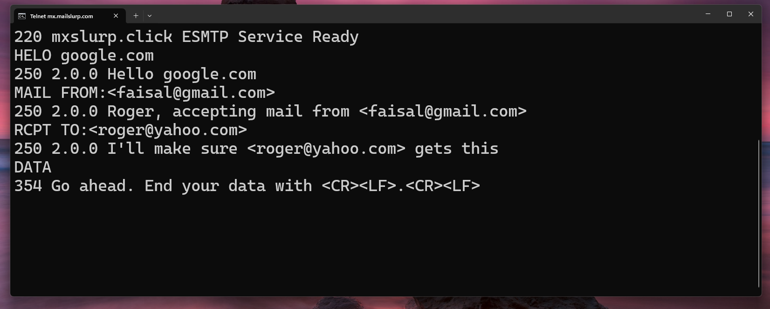
Try SMTP interaction for yourself:
Application Layer
2-<number>

Slide 12
SMTP: final words
SMTP uses persistent connections
SMTP requires message (header & body) to be in 7-bit ASCII
SMTP server uses CRLF.CRLF to determine end of message
comparison with HTTP:
HTTP: pull
SMTP: push
both have ASCII command/response interaction, status codes
HTTP: each object encapsulated in its own response message
SMTP: multiple objects sent in multipart message
Application Layer
2-<number>

Slide 13
Mail message format
SMTP: protocol for exchanging email messages
RFC 822: standard for text message format:
header lines, e.g.,
  To:
  From:
  Subject:
  different from SMTP MAIL FROM, RCPT TO: commands!
Body: the “message”
  ASCII characters only
header
blank
line
body
Application Layer
2-<number>

Slide 14
Mail access protocols
user
agent
mail access
protocol
user
agent
SMTP
SMTP
(e.g., POP,
IMAP)
sender’s mail
server
receiver’s mail
server
SMTP: delivery/storage to receiver’s server
mail access protocol: retrieval from server
  POP: Post Office Protocol [RFC 1939]: authorization, download
  IMAP: Internet Mail Access Protocol [RFC 1730]: more features, including manipulation of stored messages on server
  HTTP: gmail, Hotmail, Yahoo! Mail, etc.
Application Layer
2-<number>

Slide 15
POP3 protocol
S: +OK POP3 server ready
C: user bob
S: +OK
C: pass hungry
S: +OK user successfully logged on
1. authorization phase
client commands:
  user: declare username
  pass: password
server responses
  +OK
  -ERR
2. transaction phase, client:
list: list message numbers
retr: retrieve message by number
dele: delete
quit
C: list
S: 1 498
S: 2 912
S: .
C: retr 1
S: <message 1 contents>
S: .
C: dele 1
C: retr 2
S: <message 1 contents>
S: .
C: dele 2
C: quit
S: +OK POP3 server signing off
Application Layer
2-<number>

Slide 16
POP3 protocol
3. Update phase
Purpose: The server processes the commands from the transaction phase, finalizing any deletions or updates.
Commands: This phase typically occurs after the QUIT command.
Responses: The server acknowledges changes and closes the connection
Application Layer
2-<number>

Slide 17
POP3 (more) and IMAP
more about POP3
previous example uses POP3 “download and delete” mode
  Bob cannot re-read e-mail if he changes client
POP3 “download-and-keep”: copies of messages on different clients
POP3 is stateless across sessions
IMAP
keeps all messages in one place: at server
allows user to organize messages in folders
keeps user state across sessions:
  names of folders and mappings between message IDs and folder name
Application Layer
2-<number>

